Slide 1

Inventory Transaction Report
*Data provided should be considered CONFIDENTIAL and PROPRIETARY*
©2011-2023 MNX Global Logistics. All rights reserved.
3/23/2023 10:55 PM
Print User : selenium.automation

Slide 2
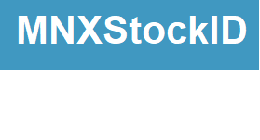
Inventory Transaction Report
*Data provided should be considered CONFIDENTIAL and PROPRIETARY*
©2011-2023 MNX Global Logistics. All rights reserved.
3/23/2023 10:55 PM
Print User : selenium.automation

